Slide 1
A Big City Adventure Awaits
Laura Clark, Christine Mitchell, Josh Stephens

Slide 2

Why This Topic? We all enjoyed working with maps.
Notes:
Our team was interested in creating a fun and adventurous project showcasing the tools and skills that we learned throughout the course. We all enjoyed working with maps. So, we ALL thought how fun it would be to plan a trip to select cities by creating a layered map in tableau.

Slide 3







We are Here to Help
You plan for a BIG CITY Adventure!
Notes:
Before you grab your walking shoes, camera, and water bottle, to explore “The Big Apple” or “The City”, you will need to plan for your big city vacation adventure and we are here to help

Slide 4


You will have an
Interactive Experience Featuring...
Notes:
You will have an interactive experience where you can explore maps featuring

Slide 5


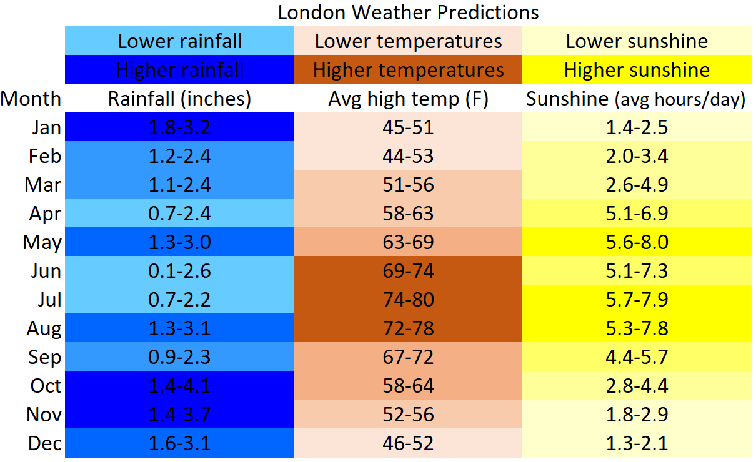

You may ask yourself, “when should
I plan my adventure?”
Notes:
You may ask yourself, “when should I plan my adventure?” Considering there will be a lot of walking, our team recommends that you plan your trip when you will be the most comfortable to visit. We felt that weather could impact your comfort level. So,we will provide a table predicting the average maximum temperature, precipitation, snowfall (NYC) and sunlight (London) per month so you can decide the optimal time frame to book your trip!

Slide 6




Next, where should you book your hotel?
Notes:
We will provide a map of each of the cities with a layer of hotel accommodations that include not only the location, but the price category, and the average rating.

Slide 7

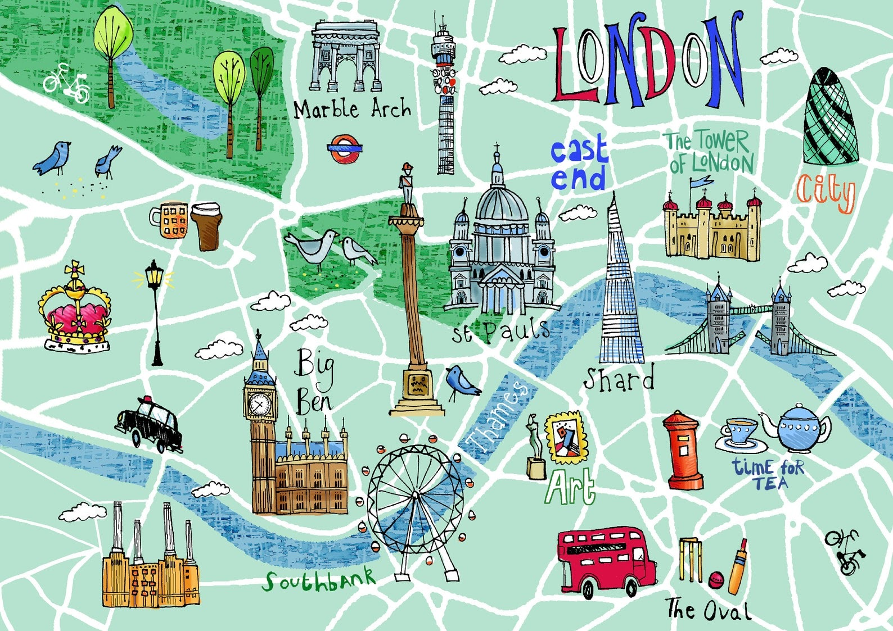
Itinerary Made Easy
Notes:
For those who want to make the most out of your trip...
You will have the option to add an additional layer to your city map that group nearby points of interest so that you can optimally create your daily itinerary!

Slide 8



Do you need to refuel for the day?
Or want to add to your cultural culinary experience?
Notes:
Do you need to refuel for the day? Or, do you want to add to your cultural culinary experience?
You will have the option to add yet another layer to our map. This time you can add nearby restaurants that will include their location, the type of restaurant, price category and average rating.

Slide 9

Sneak Peak
of our User Dashboard...
Notes:
Utilizing Tableau, let’s take a sneak peak of our dashboard...use this as back up if problems with tableau.

Slide 10
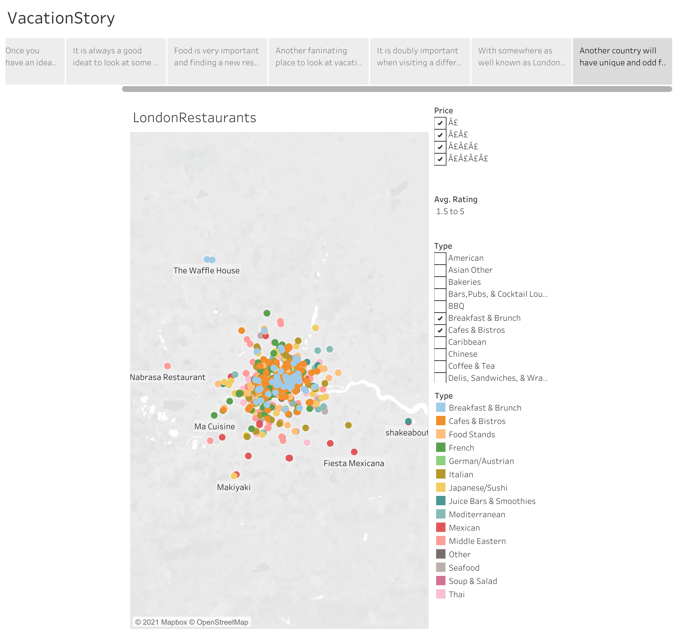



Notes:
First, let’s preview London’s restaurants...
(this slide can be hidden)

Slide 11

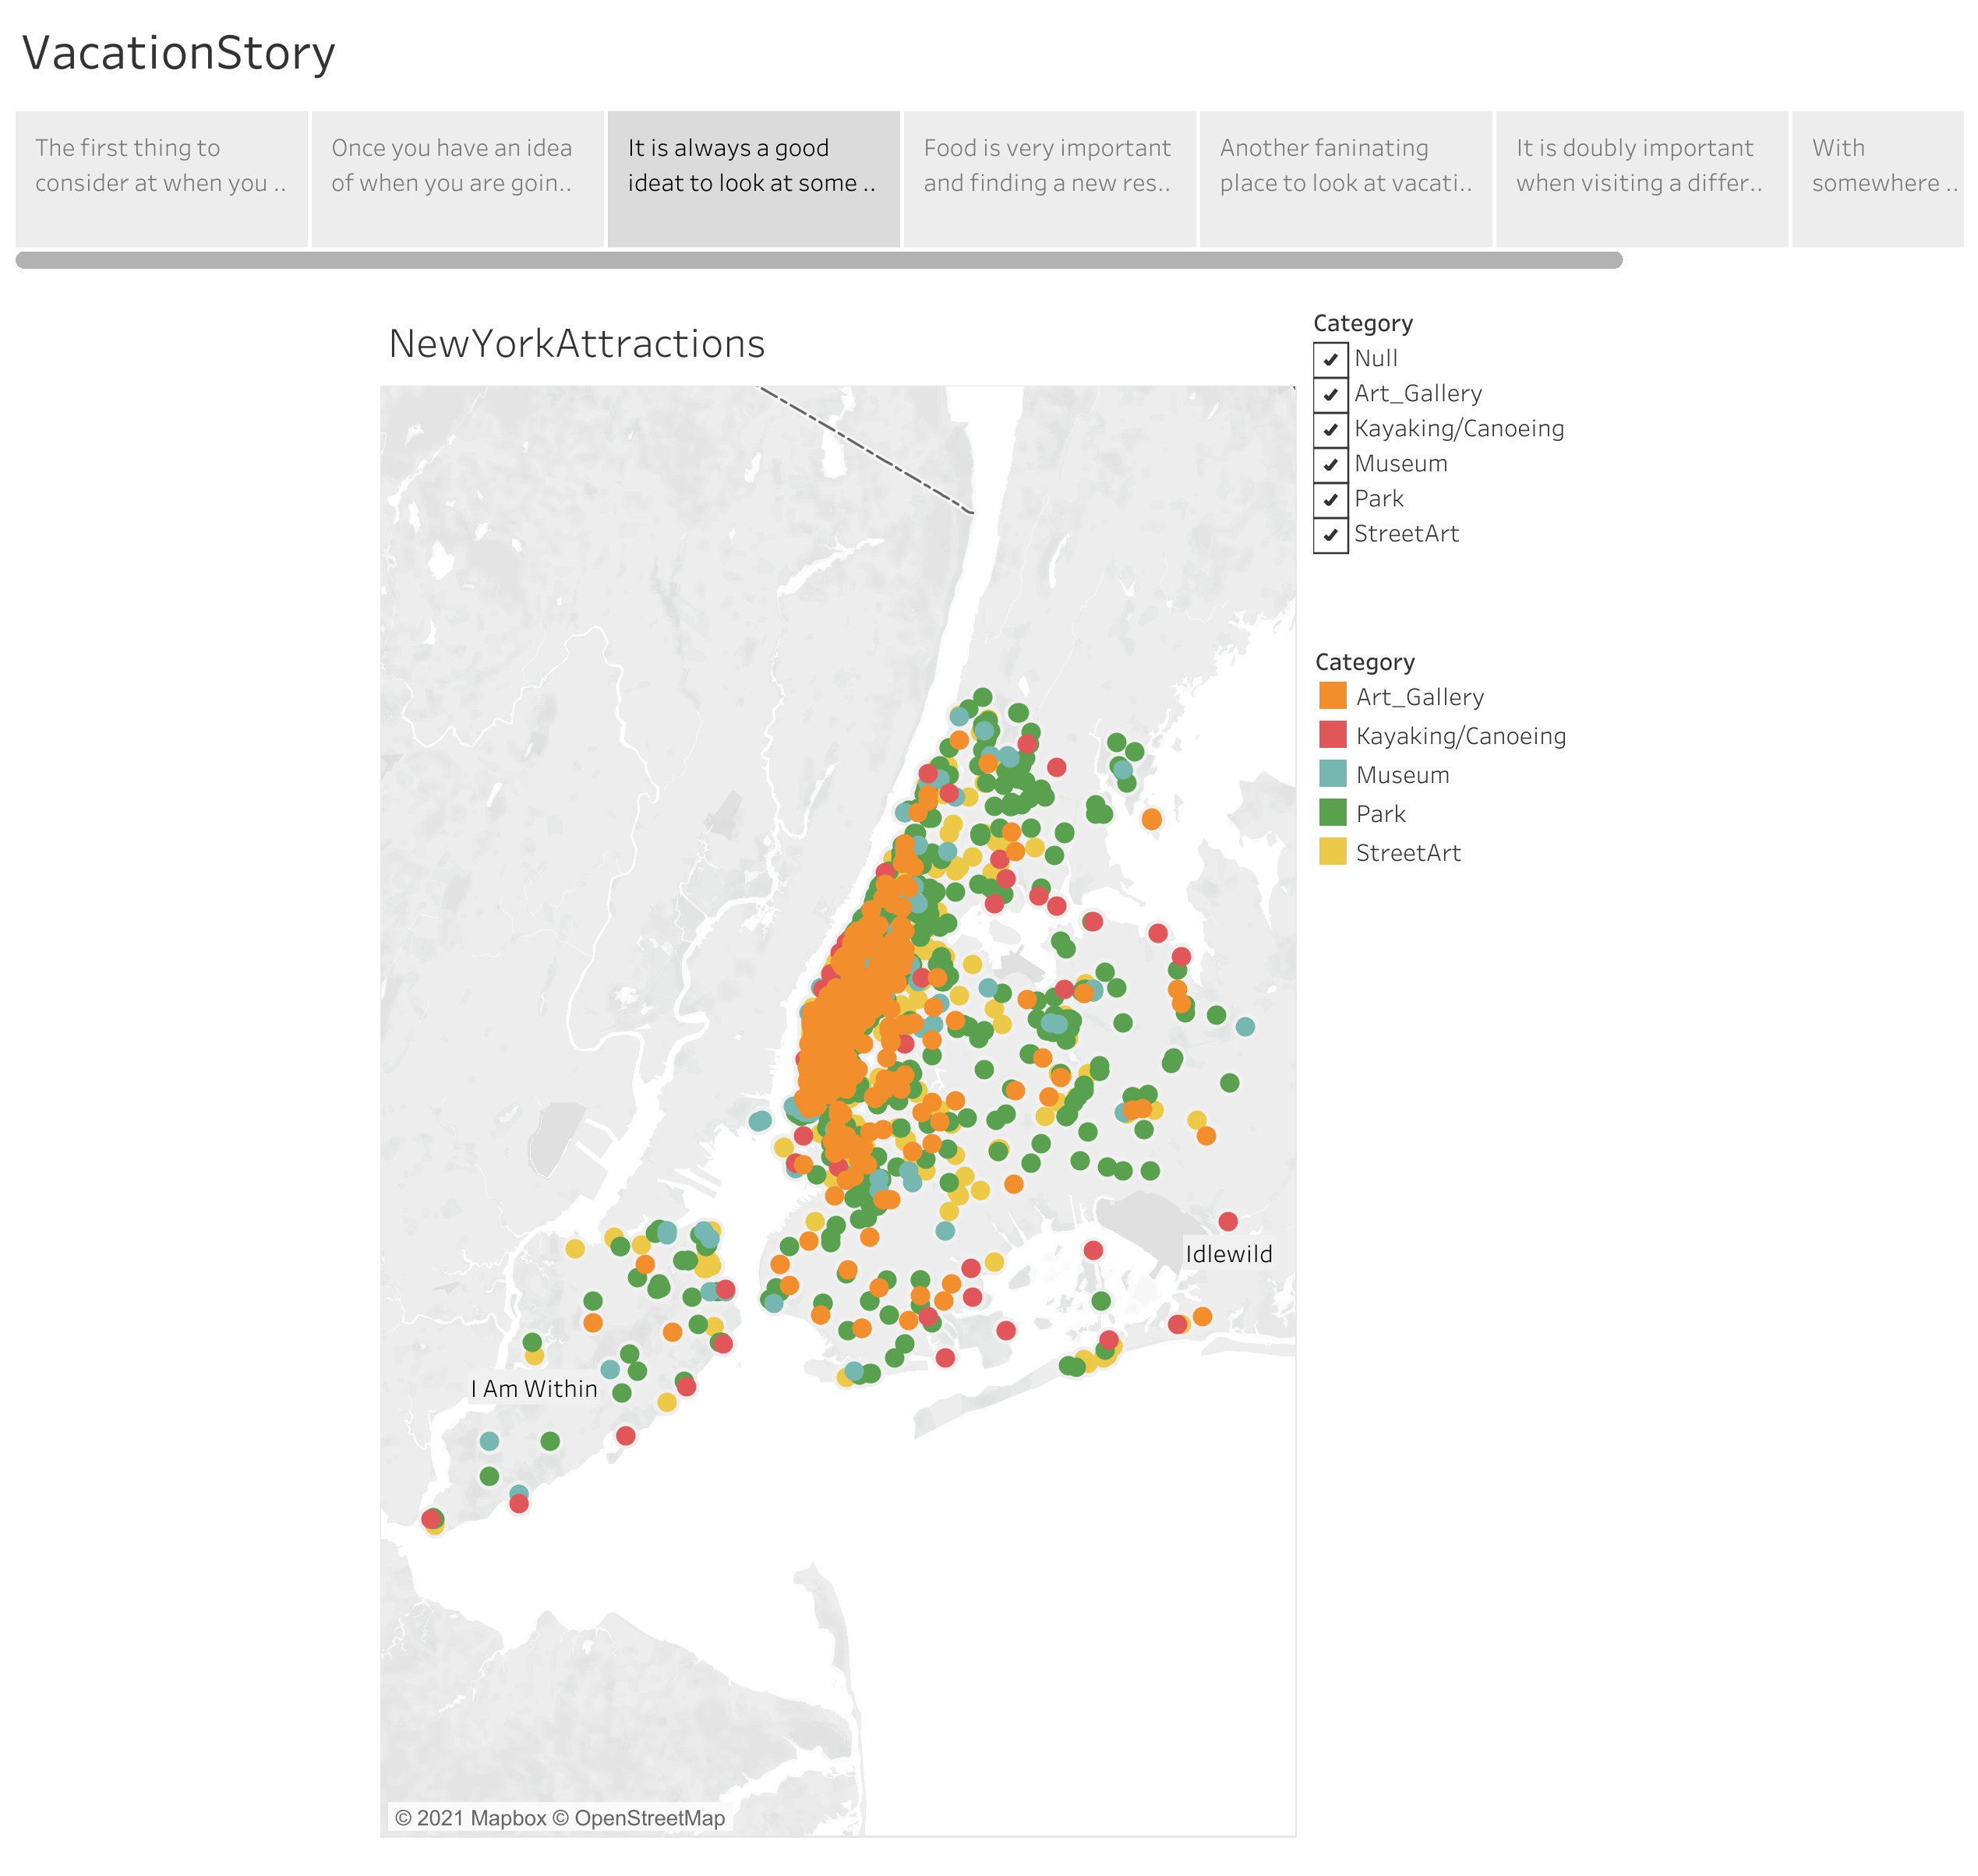


Notes:
Next, is an example of points of interests on NYC map.
(this slide can be hidden)

Slide 12
Lets Demonstrate
Notes:
Laura will lead our demonstration. :)
(this link goes directly to the public tableau presentation: https://public.tableau.com/app/profile/laura.clark2190/viz/VacationProject/VacationStory?publish=yes)

Slide 13







So now that you have an ideal itinerary,
go book your trip!
Notes:
So, now that you have the ideal itinerary, go book your trip...Josh, will take us behind the scenes.

Slide 14
Behind the Scenes
Notes:
Now that you’ve seen how our project functions, we’re going to open the curtains a bit and let you see the Wizard!

Slide 15




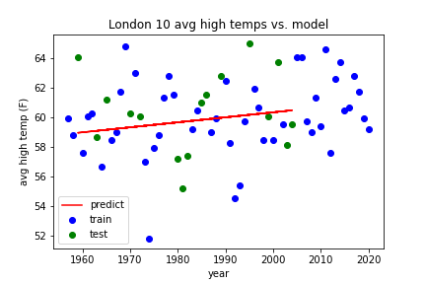
Toolkit
Toolkit
Notes:
We used a variety of tools for our project and we’ll get into more details as we progress.

Slide 16

Data Exploration
Notes:
We explored a variety of data sources for weather and points of attractions in our two cities.

Slide 17

Weather Data
London:
Source: https://www.metoffice.gov.uk/pub/data/weather/uk/climate/stationdata/heathrowdata.txt
More information: https://www.metoffice.gov.uk/research/climate/maps-and-data/historic-station-data
NYC:
Source: https://www.weather.gov/wrh/Climate?wfo=okx
Notes:
We first obtained historic monthly weather data from 1948 to current from both country’s national weather service websites. While various features were available, we focused on the four you saw earlier, average high temperature, total rainfall, snowfall for New York, and sunshine hours for London.
NYC: Each month includes the following details: Mean daily maximum temperature, Mean daily minimum temperature, Total precipitation, and Total snowfall.
Using vlookups, the data was consolidated from multiple tables and worksheets into one CSV file that mimicked the format of the London data. The dataset was loaded into a DataFrame and grouped by month. Averages and minimum and maximum values were captured.

Slide 18
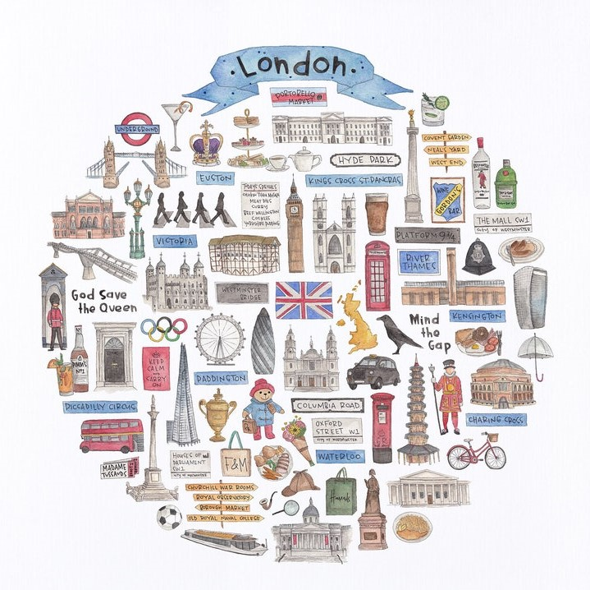

Points of Interest Data
London:
Source: http://tour-pedia.org/about/datasets.html
NYC:
Data.gov was used and these were all the datasets pulled
https://catalog.data.gov/dataset/new-york-city-museums
https://catalog.data.gov/dataset/new-york-city-art-galleries
https://catalog.data.gov/dataset/new-york-city-water-trail-kayak-and-canoe-launch-sites
https://catalog.data.gov/dataset/directory-of-temporary-public-art
https://catalog.data.gov/dataset/nyc-parks-monuments
credit: www.etsy.com/listing/809496152/london-icon-watercolor-illustration
Notes:
Next, to allow our travelers to have lots of options while exploring their city, we wanted to allow the selection to display a variety of points of interest. We leveraged tour-pedia.org APIs to build datasets for London. For New York, we retrieved data sets from data.gov including museums, art galleries, and park monuments.

Slide 19


Food and Lodging Data
NYC & London: Source: https://www.yelp.com/developers/documentation/v3/business_search YELP Business Search API
Notes:
Finally, for both cities, we used Yelp APIs for food and lodging. We ran into a challenge here, because each call is limited to 50 records with a total limit of 200 records with the established parameters. We really wanted a larger selection of restaurants for the user to choose from. So, we created and ran over 20 batch per city with different parameters, ie the restaurant type, to build our dataset of over 4000 records for each city.

Slide 20
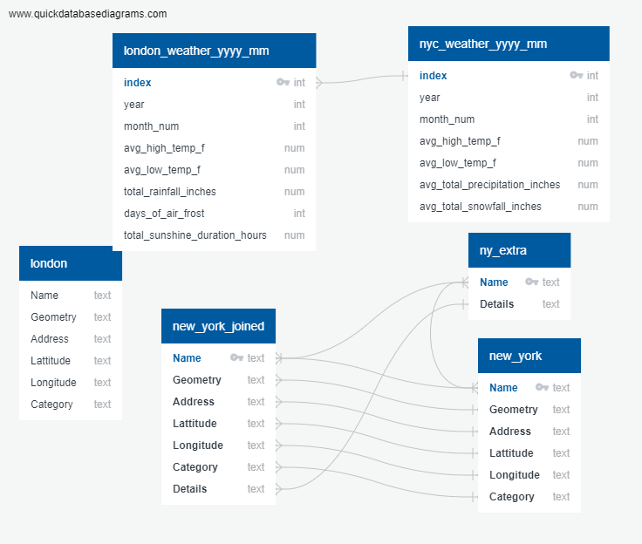

Database
Notes:
Next, we’ll look briefly at our database. Our Postgres database was used to hold our historic weather data which is later read by our machine learning models. The database also holds two New York attraction data tables which are joined together as our Entity Relationship Diagram shows.

Slide 21
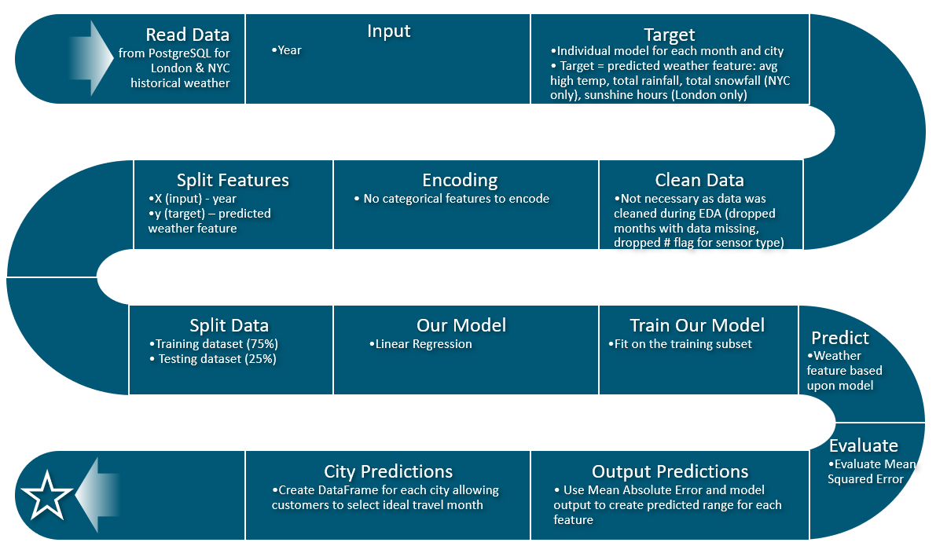
Model Flow Chart – Linear Regression Model
Notes:
For the machine learning portion of our project, we created a number of simple linear regression models. We tried several different approaches and found that individual models for each weather feature, city, and each month gave us the best overall performance. Thus, we ended up using a total of 72 models in our project to create our predictions.
We read in the historic weather data from Postgres.
Our input is the year and our target is the individual weather feature.
No cleaning was necessary in our model and only minimal cleaning was needed during the EDA phase. Encoding was not needed either.
We split our dataset into training which was 75% of the data, and the remaining 25% of the dataset was used to test our model performance.
After training our model, generating the predictions, and gathering our model performance, our model outputs the coefficient, intercept, Mean Squared Error, and Mean Absolute Error.
To build our predictions, we use the classic equation y = mx + b. We use each model’s coefficient multiplied by the year 2022 and add the model’s intercept to get the prediction for 2022.
We then create prediction ranges by adding and subtracting the Mean Absolute Error to the model prediction.

Slide 22

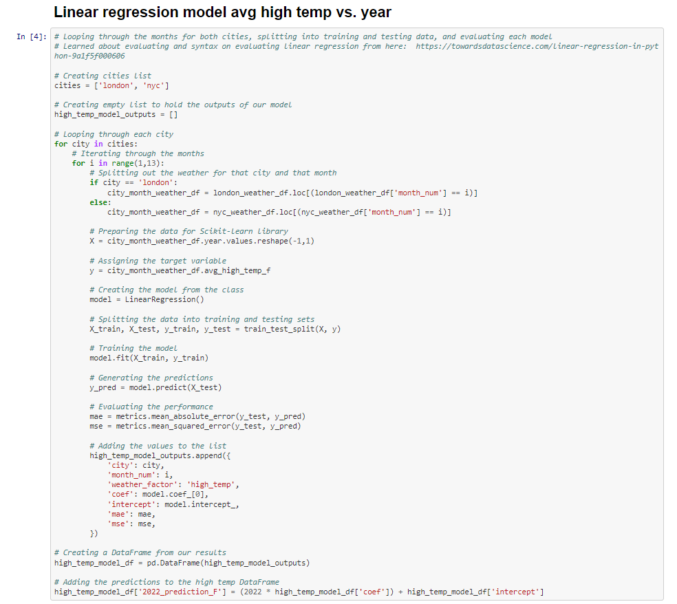

Utilized a nested loop to loop through the months for both cities for each weather element splitting into training and testing data.
Notes:
With so many individual models needed in our project, we leveraged nested loops to do the heavy lifting. We iterate through each city and each month for the individual weather features. The code shown, for example, creates a total of 24 models for average high temperature, 12 for London and 12 for New York. It outputs the values to a list that are then converted to a DataFrame and our predictions are added.
We could have refactored our code to make it cleaner and easier to read in a few ways. First, using a random_state value would have made our model performance more consistent instead of obtaining different values with each running of the code which got to be confusing! Next, we could have created a function to run the model and we did leverage this approach later when creating neural network models to compare performance.

Slide 23

Weather Prediction Presentation
Notes:
So, all this model code was to generate data to help our travelers make the best decision of when to travel! And as a personal story, I can attest that When does matter!

Slide 24
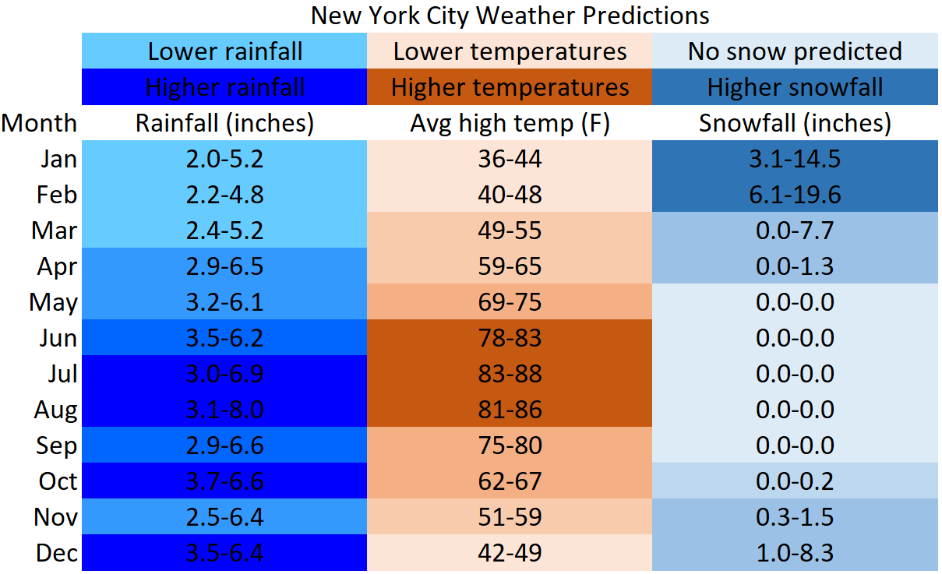
New York Weather Predictions
Notes:
My wife and I were married in early March and for our first anniversary we wanted to travel to New York City. While planning our trip if we had known that the average high temperature would likely be only 48-54 degrees, I would have “gently suggested” that we celebrate a month or two later when the weather is much more to our liking in the 60s and 70s! This is especially true knowing what I know now about how the winds whip around with all those skyscrapers!

Slide 25
London Weather Predictions
Notes:
We field tested various color schemes with a non-technical audience (my wife) in an attempt to make our data as easy as possible to understand. One great suggestion was to display sunshine hours per day instead of the hours per month we originally showed. We also leveraged several other suggestions from Storytelling with Data by (k)Naflic to reduce visual clutter and enhance effectiveness. We used an online simulator to ensure that our visualization is accessible to those who are color blind.

Slide 26

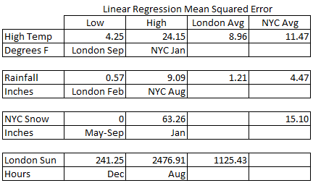
Model Performance & Analysis
* Full model results and performance are included in the appendix at the end.
Notes:
Next, we’ll look at how our model performed. This table shows the Mean Squared Error values for our models. For each weather feature, you’ll see the low, high, London Average, and New York average. You may notice the value for sunshine hours is significantly higher. The scale of this feature, sunshine hours per month, was higher than other features thus resulting in higher MSE.

Slide 27
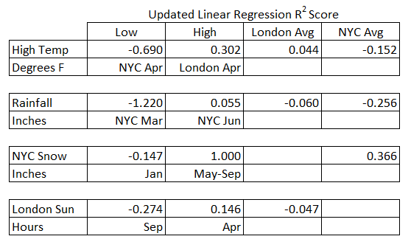
Model Performance & Analysis R-squared Score
* Full model results and performance are included in the appendix at the end.
Notes:
Newly inserted slide: During our presentation, we were asked about r2 scores which we had not originally captured. We reran the model, this time adding a random_state value, and the r2 scores of our updated model are shown below. There is not a strong correlation between our values and the weather can be difficult to predict precisely. This is even true for meteorologist predicting tomorrow's weather. Since our project was to show the big picture for our travelers and we created prediction ranges instead of trying to predict precise values, we're hopeful our predictions will both be helpful to travelers and reasonably accurate.

Slide 28

Project Challenges
Data Limits on APIs
Model Performance Varied
Notes:
There were a number of challenges that we encountered during our project.
We had limits on APIs and we were able to overcome this challenge by running them in clusters.
And as mentioned previously, model performance varied each time code was run. Had we leveraged random_state, we would have increased consistency and made things easier.

Slide 29

If Only We Had More Time
Create an App
Add additional Cities
Tie in Partnerships
Complete and Consolidated Itinerary
Predict Busy Travel Season
Notes:
If our team had more time, there are a few things we would pursue.
First, we would create a mobile app to put these capabilities into travelers’ hands as they are planning their trip and while on their trip.
We would add additional world cities beginning with those most popular with US travelers.
We also want to tie in other partners like airlines, hotels, and car rental companies and allow direct reservations with those sites, leveraging APIs in order to do so.
It also would be nice to build a consolidated, detailed itinerary so you have all the details at your fingers tips to share or refer to while on your trip. So, when you’re on your trip you remember the activities that caught your attention while you were making your plans.
Finally, we’d like to include context of peak and off-peak travel times so our travelers can optimize their experience.
Now that we’ve shared a peak under the hood, we’d like to open the floor to any questions you may have.

Slide 30
Q & A

Slide 31
Appendix
Notes:
We are utilizing a variety of different data sources for our two selected cities.

Slide 32
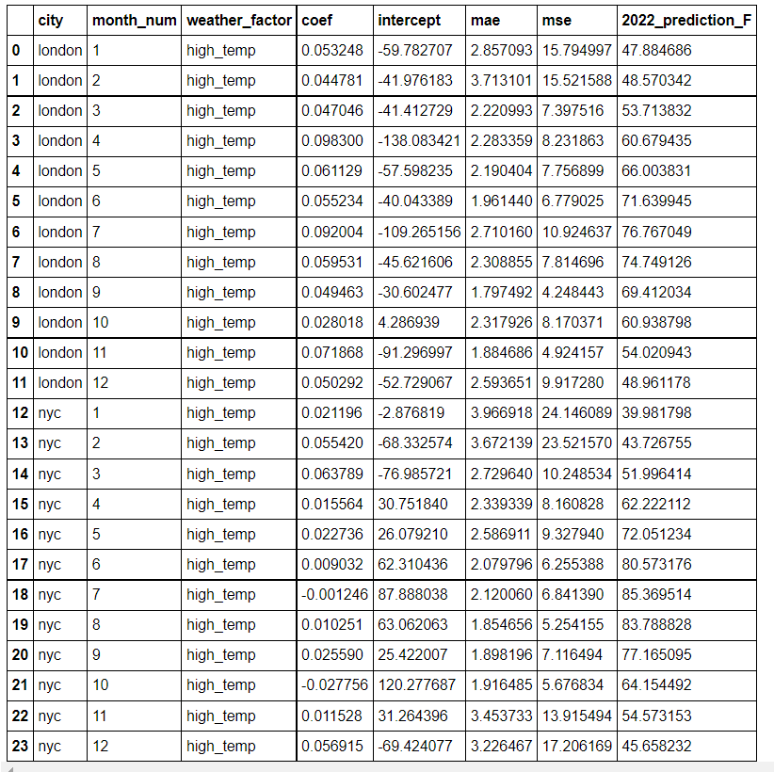

High Temperature Model

Slide 33
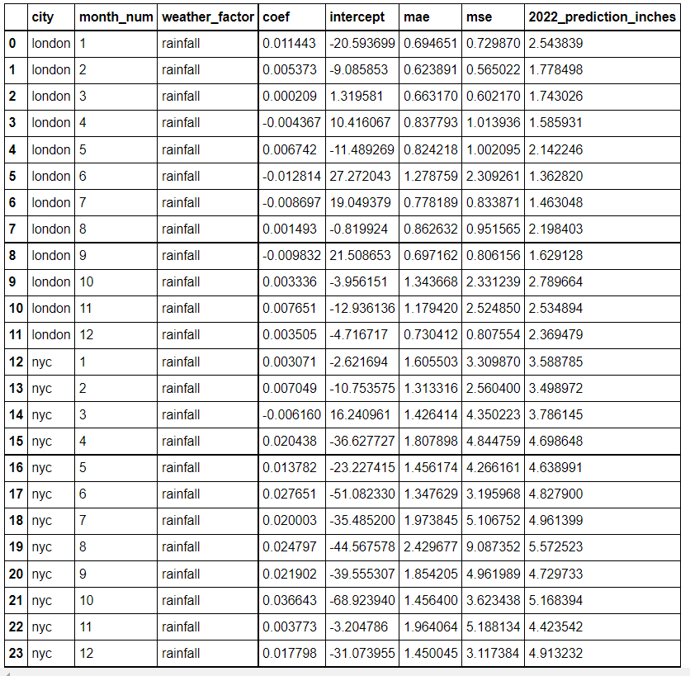

Precipitation Model Results

Slide 34

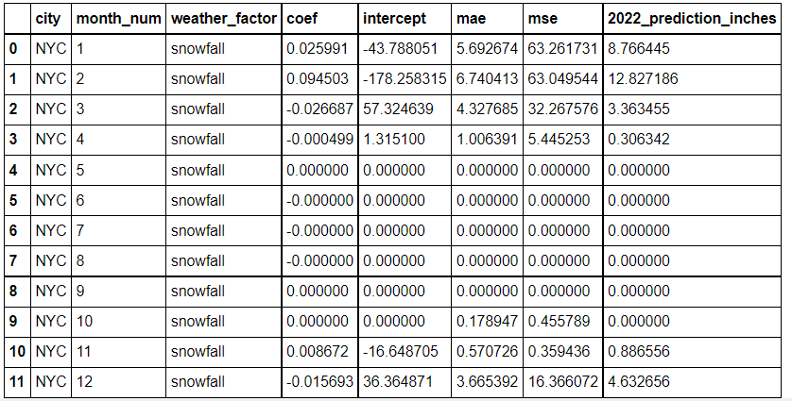
NYC Snowfall Model Results

Slide 35

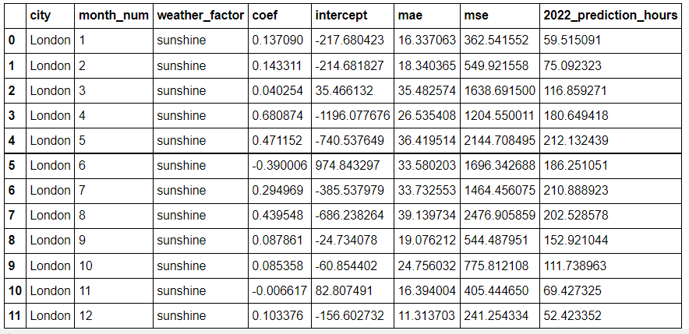
London Sunshine Model Results

Slide 36
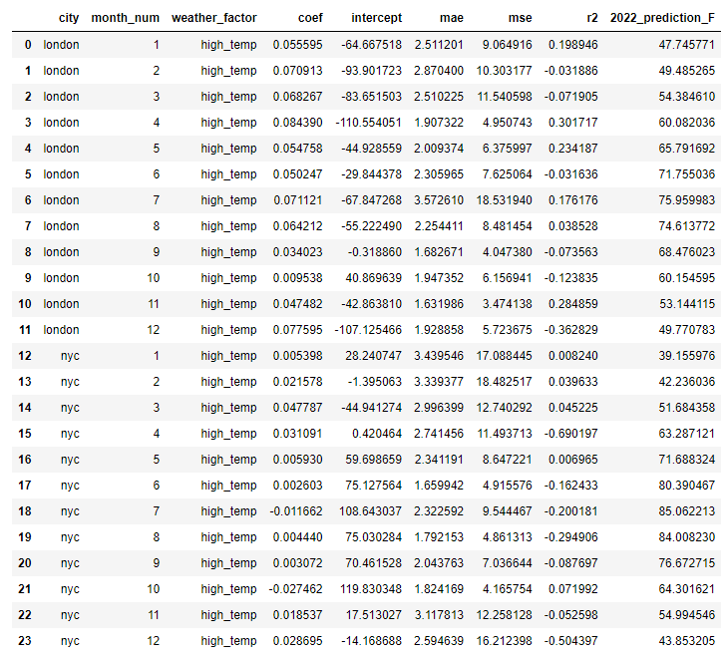

High Temperature Model with R-squared
Because we did not use a random_state value in earlier stages of our models, the outputs from these models differ and cannot be compared directly to the results above. Next time, we would use a random_state value throughout to increase consistency and reduce pain points.

Slide 37
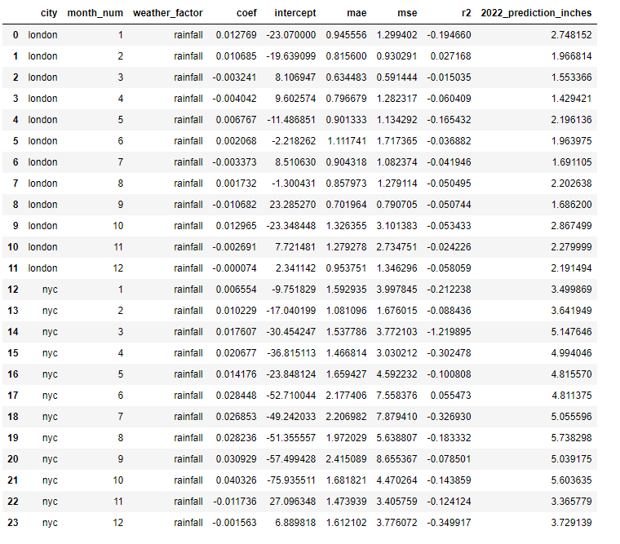

Precipitation Model with R-squared
Because we did not use a random_state value in earlier stages of our models, the outputs from these models differ and cannot be compared directly to the results above. Next time, we would use a random_state value throughout to increase consistency and reduce pain points.

Slide 38

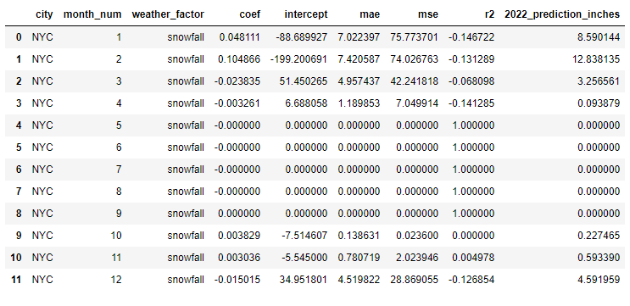
NYC Snowfall Model with R-squared
Because we did not use a random_state value in earlier stages of our models, the outputs from these models differ and cannot be compared directly to the results above. Next time, we would use a random_state value throughout to increase consistency and reduce pain points.

Slide 39

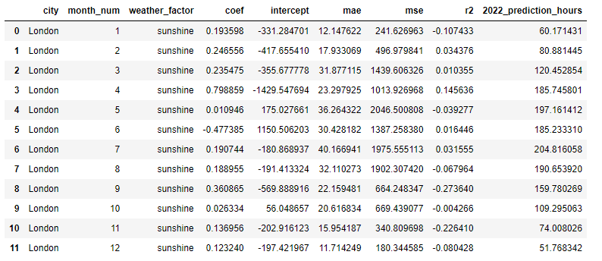
London Sunshine Model with R-squared
Because we did not use a random_state value in earlier stages of our models, the outputs from these models differ and cannot be compared directly to the results above. Next time, we would use a random_state value throughout to increase consistency and reduce pain points.

Slide 40
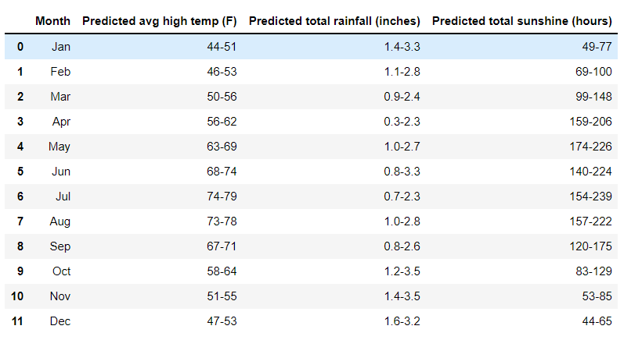

Prediction Creation
To evaluate our models, we utilized Mean Squared Error (MSE). Initially we planned to show predictions for 2022 and 2023 however the ranges were nearly identical, so we only show one column for each weather feature. See London below.

